Slide 1
WEEK 1: PROBLEM CLASSIFICATION
GROUP 3
Members:
Cáceres Díaz, Renzo (11200004)
Escobar Villa, Andrés David (6200075)
Gonzales Aburto, Ricardo Daniel (18200061)
Huamaní Avendaño, Dulce María (18200219)
Molina Yupanqui, Flor Giannina (18200164)
Palomino Loa, Junior (18200172)
Quispe Vega, Anthony Yair (18200179)
Vera León, Bryan (18200124)

Slide 2

TABLE OF CONTENTS
COMPLEXITY THEORY
01
02
CLASSIFICATION OF ALGORITHMIC PROBLEMS
Introduction
P problems, NP problems, full NP problems
03
CLASSIFICATION OF PROBLEMS ACCORDING TO THEIR TYPE OF RESPONSE
Decision, localization and optimization problems

Slide 3
01
COMPLEXITY THEORY
Introduction

Slide 4
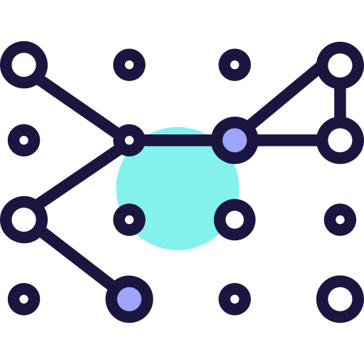
COMPLEXITY THEORY
Study how the computational cost grows, mainly in memory and time to solve a certain problem in relation to what the size of that problem grows
An example:
I want my computer to sort a few numbers . Obviously, it will cost you more to sort 1000 numbers than 100 numbers, but how much it costs you more How much it will cost him to order a million or 100 million? Complexity theory is dedicated to measuring these things
Complexity theory has measures of how that computational cost of solving a problem increases with respect to the size of the problem.

Slide 5
EXAMPLE
We continue with the example of numbers
Imagine that the time to order 1000 numbers is 1 sec, that order 10k is 10 sec, in ordering 20k late 20 sec, then we conclude that the complexity of this batch of numbers is linear, because mathematically the function of time to find the solution with respect to the size of the problem is linear, but it may happen that that function for a problem is constant, quadratic , or exponential ,
If we realize that the time to order 1k is 1 sec, 10k is 2 sec, 100k is 3 sec and so on, it is an example of logarithmic growth, which is an assumable cost, the problems of constant growth are stable, the quadratic, polynomial basically are somewhat more expensive, and then come the exponentials that are of very high cost. And then come the P and NP problems, which their complexity according to the problem can vary.

Slide 6

Difference between problem and algorithm
The complexity of a problem is very different from the complexity of an algorithm. A problem can be solved from different algorithms, some more effective than others, for example in the case of ordering, there are very efficient algorithms such as HeapSort or MergeSort which the complexity or cost is nlogn, and others as the bubble method, which complexity is more expensive because they are n squared
The complexity of a problem is that of the best algorithm that solves it. That is, they will see several ways to solve the problem, but it is up to us to discover which is the best algorithm that solves it.

Slide 7
02
CLASSIFICATION OF ALGORITHMIC PROBLEMS
P problems, NP problems, full NP problems

Slide 8
CLASSIFICATION OF ALGORITHMIC PROBLEMS
PROBLEMS P
02
FULL NP PROBLEMS
03
PROBLEMS NP
01
Set of problems in which we can find an answer to the problem in a reasonable time.
They are a subset of the NP problems that are characterized by being the most complex. They seem intractable but no one has been able to prove it.
The NPs - Complete are equivalent, this means that:
If an efficient algorithm is found for an NP-complete then we have an efficient algorithm for any of them
If we test that an NP-complete has no efficient algorithms, then none do.
NP-type problems have a solution that might be difficult, but once found, it's easy to check.

Slide 9
03
CLASSIFICATION OF ALGORITHMIC PROBLEMS ACCORDING TO THEIR TYPE OF RESPONSE
Decision, localization and optimization problems

Slide 10
DECISION PROBLEMS
In a decision problem, the instances are divided into two classes: yes and no.
Examples:
Will the integer n be even?
Will the integer n be odd?
Will the integer n be prime?
Will the integer n be composed?
Will the Collatz process end if we start with the integer n?
Can the integer n be written as the sum of two primes?
Will it be possible to color a given map with four colors or less?
Will a system of polynomial equations have integer solutions?
Will the execution of a given program end?
Kinds of decision problems
*ZPP: They can be solved without error in polynomial time with randomized algorithms.
*RP: They can be solved with unilateral error in polynomial time with randomized algorithms.
*BPP: They can be solved with bilateral error in polynomial time with randomized algorithms.
.
Counting Problem Classes
*Q: Associated with decision problems in NP.
*PC: The ♯P can be reduced in polynomial time to these.

Slide 11
LOCALIZATION PROBLEMS
Location problems are those where it is about finding the best location of a facility within a geographical space.
Examples:
Least squares algorithm: Technique of numerical analysis, within mathematical optimization, given an ordered stop and a family of functions, try to find a continuous function that approximates the data, according to the criterion of minimum quadratic error.
K-Nearest Neighbor Algorithm: It is a method that simply searches the closest observations to which it is trying to predict and classifies the point of interest based on most of the data around it. It is applied in recommendation, semantic search and anomaly detection systems.

Slide 12
OPTIMIZATION PROBLEMS
It consists of a localization problem and at least one optimization criterion. In the world of computing, we seek to solve problems optimally, using the least number of resources, with efficient and fast algorithms. Where an optimal solution is a maximum (or minimum) solution with respect to a function and satisfies all constraints.
There are two types of optimization problems:
Continuous: these problems are those that can be solved by taking a range of values, commonly using real numbers, this characteristic distinguishes them from discrete optimization (combinatorics), since in that case the variables are restricted and can be binary.
Combinatorial: these problems are difficult to solve, so it is resorted to exploring only one space of solutions instead of all possible solutions, in this way the search space is reduced and thus they are solved efficiently.

